Slide 1
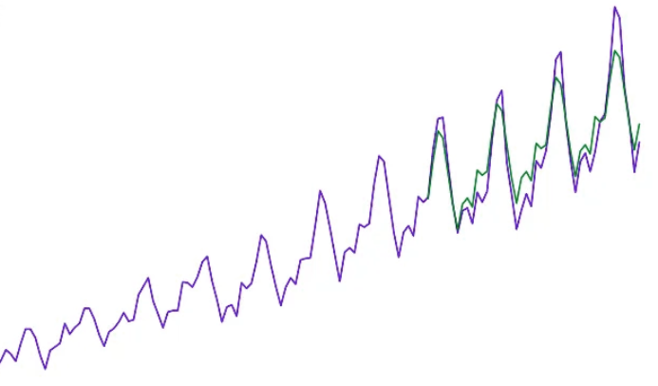
Casualties of Accidents - Time Series Forecasting

Slide 2

Team Members
Abdullah Alowais
Maryam Jathmi
Reshoof Alzweaid

Slide 3
Agenda
Problem Identification
Introduction
Model Development and Evaluation
Conclusion

Slide 4
Introduction
The aspect of this project takes a detailed look into road accident between 2005 – 2018 which includes but not limited to potential casualties due to road accidents.
The aim of this part is to forecast the number of casualties due to road accidents based on the available dataset, also this project entails experimenting on the RNN, LSTM, GRU.

Slide 5
Problem Identification
The high rate of casualties due to road accidents has become a significant concern, with devastating impacts on individuals, families, and communities. This project aims to address this pressing issue by leveraging time series forecasting techniques to model and predict the number of casualties stemming from road accidents.

Slide 6
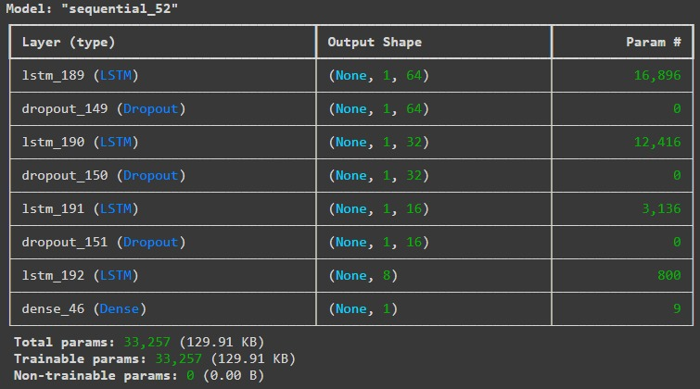
Model Development and Evaluation LSTM

Slide 7
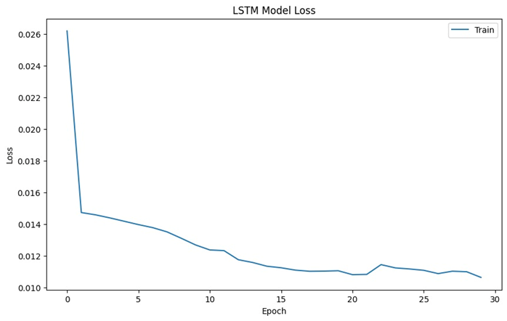
Model Development and Evaluation LSTM

Slide 8
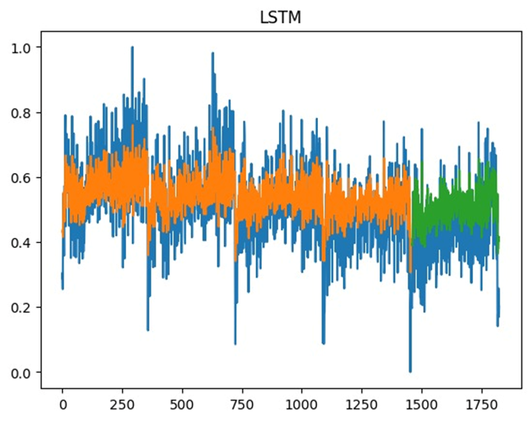
Model Development and Evaluation LSTM

Slide 9
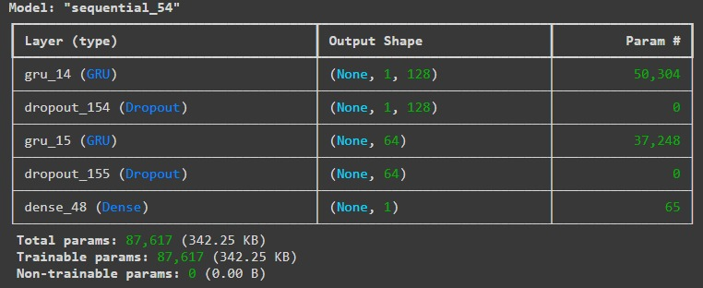
Model Development and Evaluation GRU

Slide 10
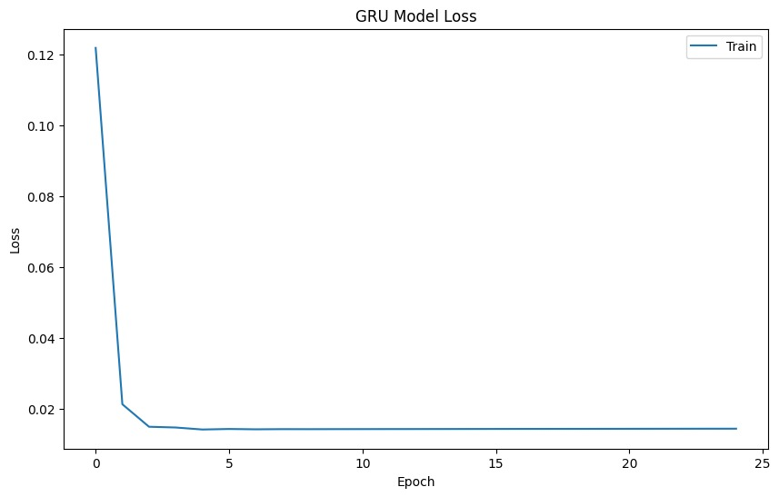
Model Development and Evaluation GRU

Slide 11
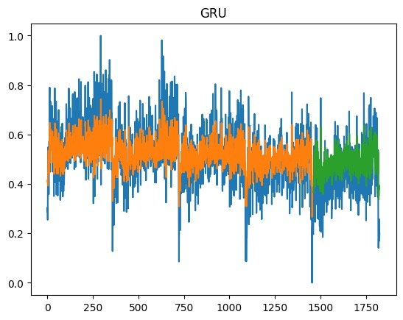
Model Development and Evaluation GRU

Slide 12
Conclusion
In conclusion, our Road Accidents project has successfully developed a predictive model that estimates the number of casualties for the upcoming days using historical data on accident dates and casualty figures. By leveraging this model, we can anticipate future casualty numbers with greater accuracy, providing valuable insights for traffic safety authorities and policymakers.

Slide 13

Thank you

